Slide 1

Machine Learning for Industrial Data Task 1 “Predicting city status”
Student Ivan Smirnov
Group J42332c

Slide 2
Task
With a dataset of one popular social network that includes more than 8.5 million records with meta-information of publications over 13 months (January 2019 to February 2020).
Each publication is described by the following meta-information:
Geoposition coordinates
Timestamps
Message information
Need to predict the number of publications in each 250x250 meter polygon for each hour 4 weeks (28 days) ahead of the last publication in the training set.
2

Slide 3
Tasks
Analyze and preprocess dataset
Find special areas
Compare different approaches
Make the forecastings for the new data
3

Slide 4
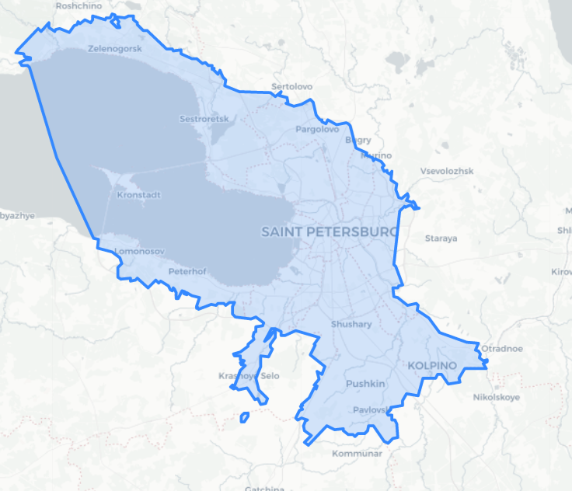
Data analyze and preprocessing
To drop geographical outliers (not in St. Peterburg boundaries) was used Open Street Map
Polygon of administrative boundaries from OpenStreetMap
4

Slide 5
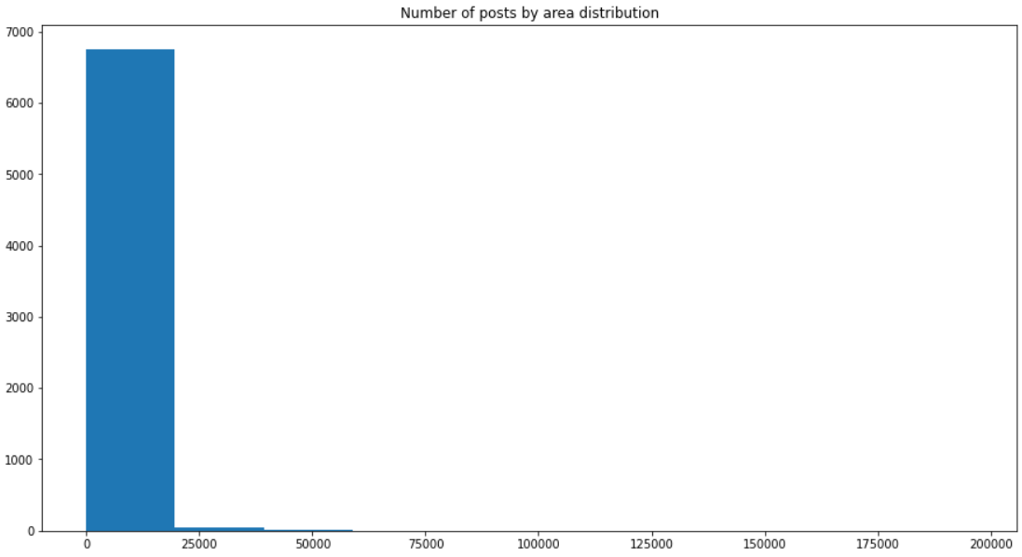
Data analyze and preprocessing
We can see, some anomalies in number of posts by area distribution.
It can relate to popularity of the places
5

Slide 6
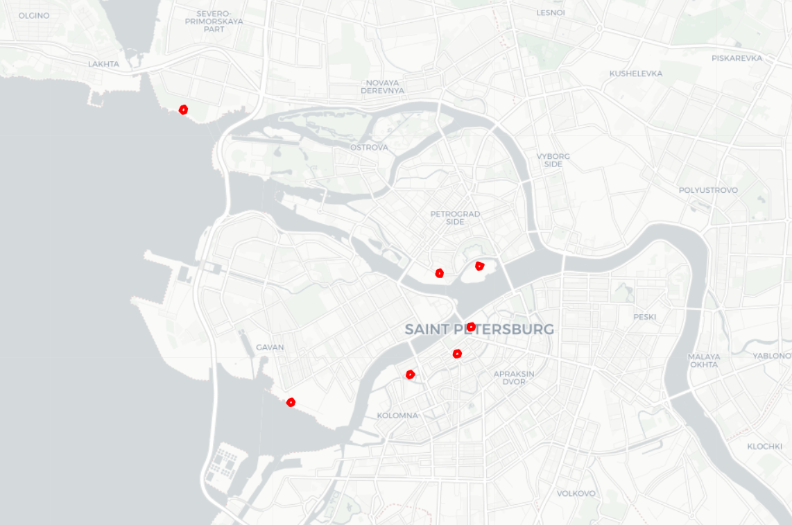
Data analyze and preprocessing
Popular places with total number of posts > 75000:
300th anniversary park
Sevkabel Port
New Holland Island
Place near by Birjevoy bridge and Stadium
Hermitage
Saint Isaac's Cathedral
6

Slide 7
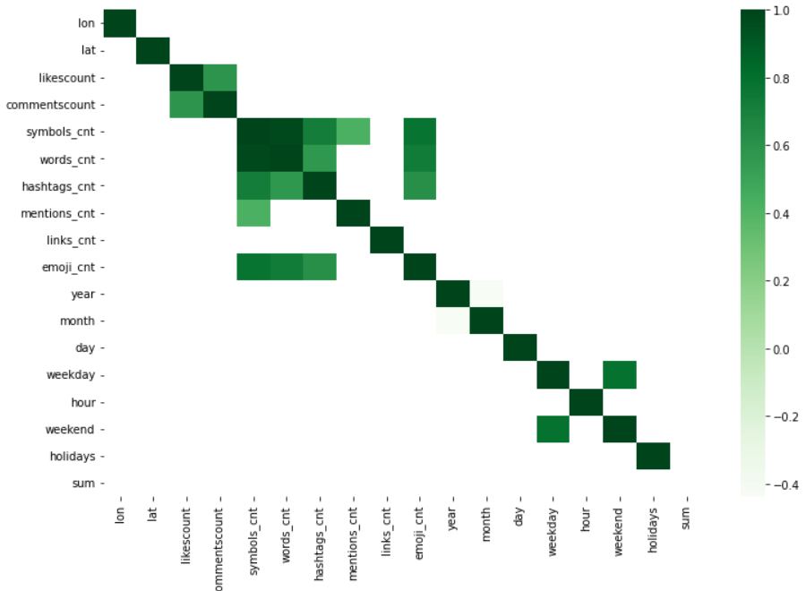
Data analyze and preprocessing
7
Correlation between features

Slide 8
Additional features
Holidays – categorical feature. Information obtained from holidays lib extended with St. Petersburg’s special dates: City day and Scarlet Sails.
Weekend – categorical feature informs about weekend status
Relations between every message meta data (emoji, tag, etc.) and total amount of messages in every location.
8

Slide 9
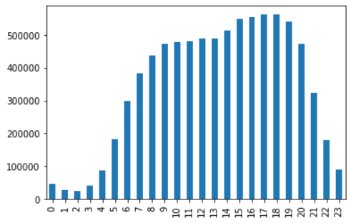
Data analyze and preprocessing
10.6% - part of the weekend’s posts in total amount of posts
Distribution of number of posts by hour
9

Slide 10


Models
AutoML solution
Gradient boosting
Was solving regression task
10

Slide 11
Metrics
Method | Score
BaseLine | 2.6
FEDOT (rfr, scaling) | 3.05
LighGBM + features | 4.27
LightGBM | 1.58
11

Slide 12
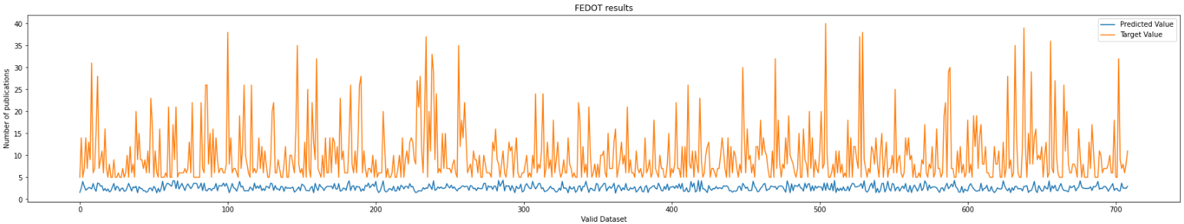
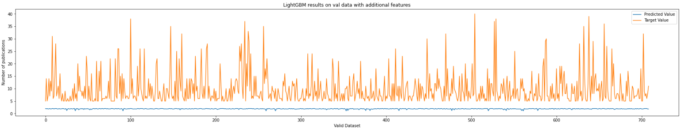
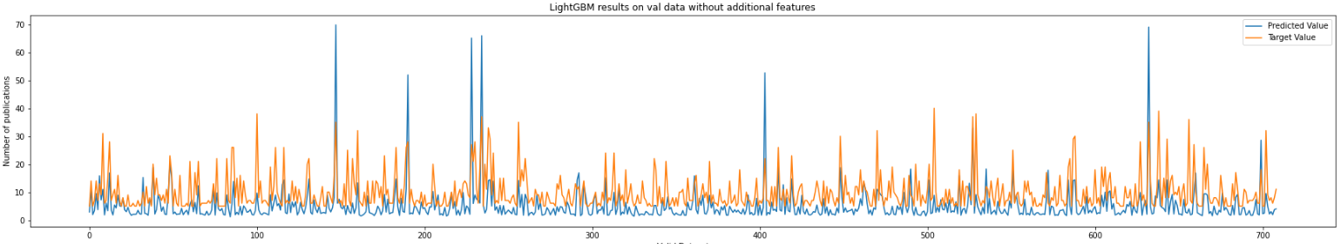
Predictions
12

Slide 13
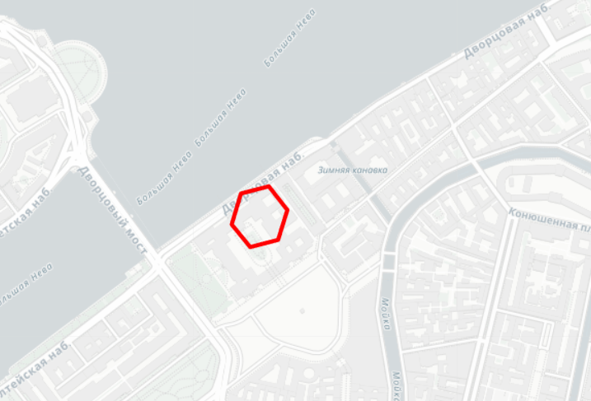
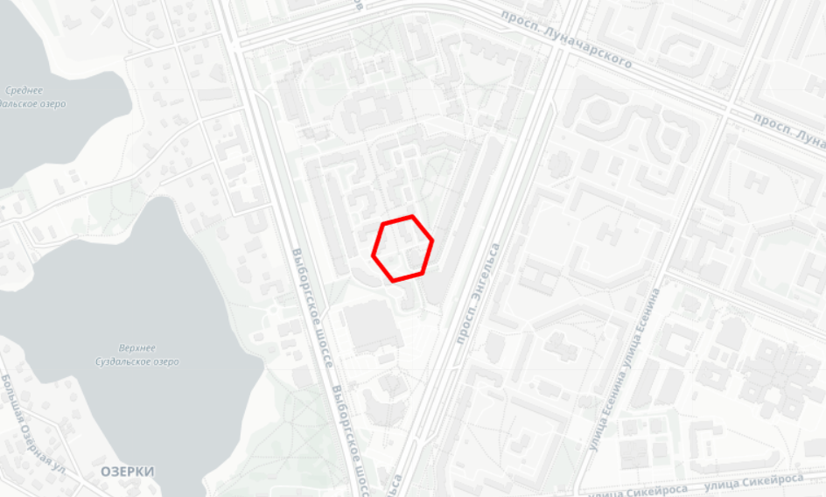
Predictions
The most popular place. Time: 2020-02-15 14:00:00
The least popular place. Time: 2020-02-09 09:00:00
Predicted: 28.0
Predicted: 1.58
13

Slide 14

Thank you for your attention

